Slide 1


Expanding Team Flightify: Predictable VFR Air Traffic Forecasting in all Major Airports in the US
Team Flightify 2.0
Supporting
Federal Aviation Administration

Slide 2







Team Flightify 2.0
FLIGHTIFY
AJ Gray
Product Owner,
Lead Developer
Sabitha Pongadan
Scrum Master,
Developer
Kimberly Cawi
Lead Researcher,
Developer
2
Nida Sharief
Developer
Vasanthi Pulusu
Developer
Bharat Challakonda
Developer
Mazen Mohamed
Developer

Slide 3
Agenda
01
Introduction
02
Exploring & Transforming Data
03
Data Modeling & Evaluating
04
Results, Conclusion & Next Steps

Slide 4
INTRODUCTION
4

Slide 5
Federal Aviation Administration
FLIGHTIFY
Mission Statement:
“Our continuing mission is to provide the safest, most efficient aerospace system in the world.”
Office:
Aviation Policy and Plans, (APO-100)
Air Traffic Organization, (ATO), Mission Support Services, (AJV), Strategy Directorate, (AJV-S)
Past State:
Team Flightify 1, Summer 2021: Data Exploration project and solution
Scale: Small (8 airports)
Predictive approach: Classification, approach was not conducive for forecasting
Deliverables: Python model, Tableau Dashboard
Current State:
Team Flightify 2.0, Spring 2022: Forecasting VFR project and solution
Scale: Large (500 airports)
Predictive approach: Generalized Poisson Regression
Deliverables: Model Visual Flight Rule (VFR) Behavior 500 airports, 7 day Forecast, ArcGIS Shape files, Tableau Dashboard.
Future State:
For the Flightify team's detailed recommendations and next steps, please refer to Slide 24

Slide 6

Problem Statement
FLIGHTIFY
The Problem
The nature of VFR flights
VFR defined
Risks introduced with flying VFR
Currently FAA does not have a way to predict
VFR traffic which causes safety risks
The Solution
Predict VFR Traffic per Airport
Notes:
Aircraft using VFR usually are not required to file a flight plan and are not automatically monitored by air traffic control. This requires additional resources to manage their flights which can cause a safety risk when airports are caught unprepared by a large influx of VFR traffic.
Therefore, Team Flightify 2.0 designed and created two solutions to predict and forecast VFR flight traffic in class G airspace for 500 major US airports. These solutions will enable the FAA to assess risk and allocate proper resources. The partner will be able to integrate the predictions into the ArcGIS (GLARE) platform.

Slide 7
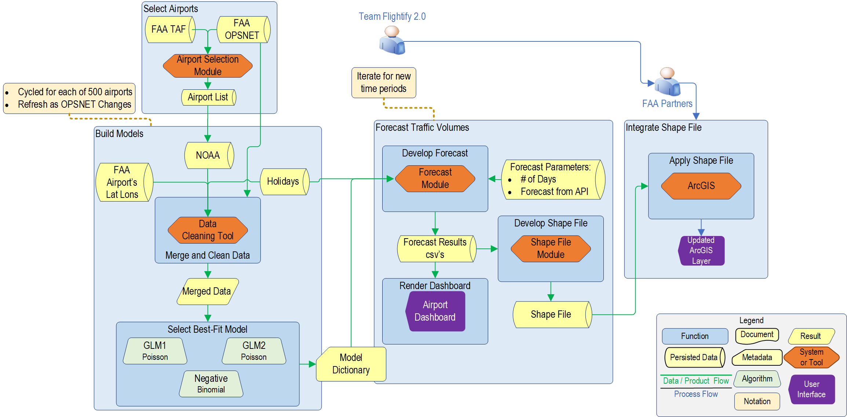
Functional Flow of Final Solution
Forecast is Run Independently
FLIGHTIFY

Slide 8
EXPLORING & TRANSFORMING DATA
8

Slide 9
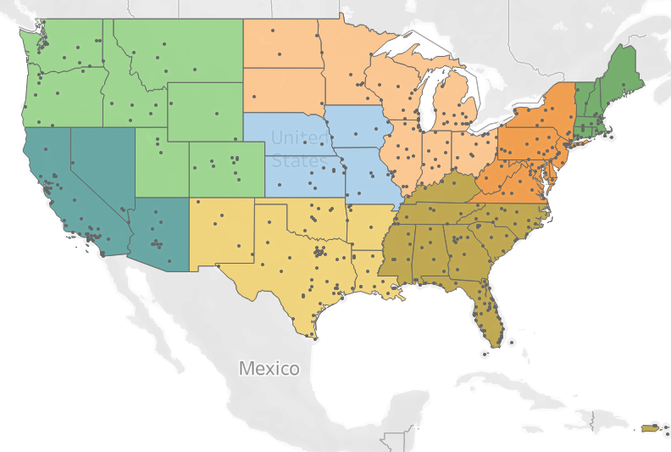
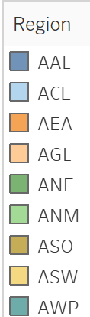
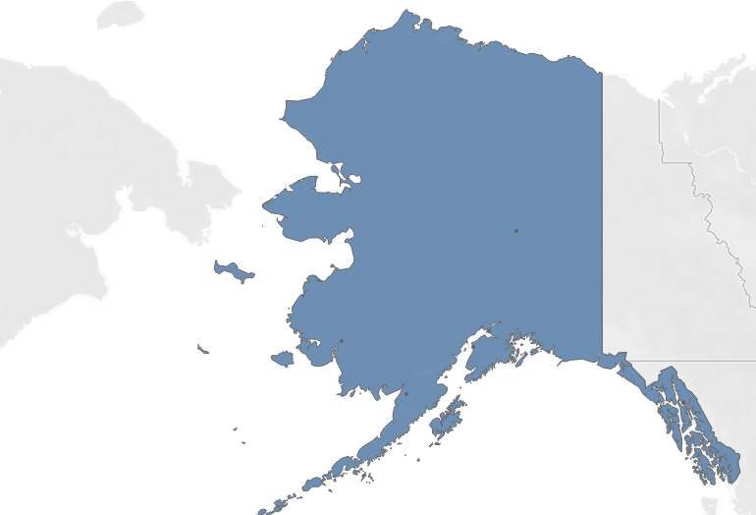
Airport Selection Process
FLIGHTIFY
Airport Selection
500 Airports in 9 FAA Regions
https://aspm.faa.gov/
TFMSC Report
TAF
TowerOps Report
Final List of 500 Airports
TAF
Notes:
We utilized the Traffic Flow Management Safety and the OPSNETTower Operations FAA databases to construct our pool of airports. We grouped airports by region and filtered on the airports that had the highest volume of VFR traffic operations from 2017 – 2021. We then selected the top 500 airports with respect to VFR traffic, representative of each region.

Slide 10
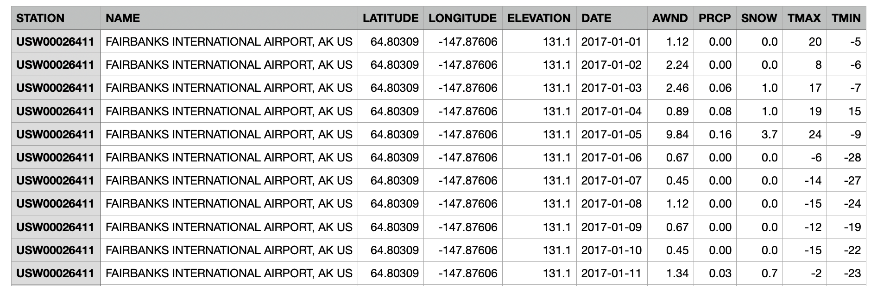
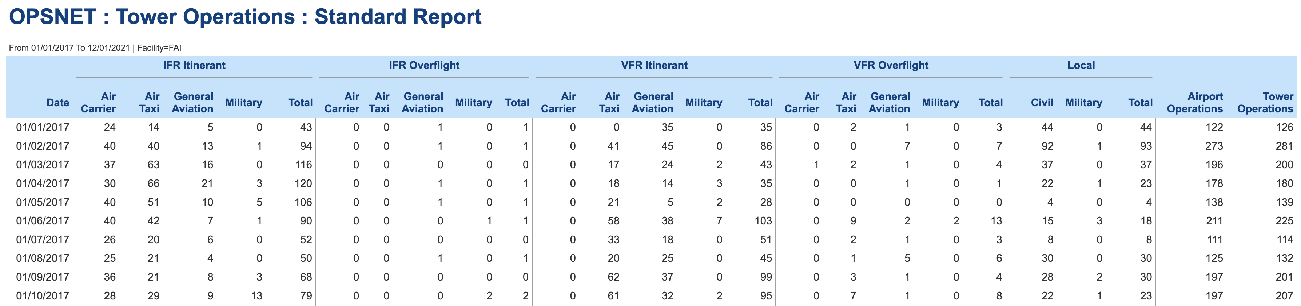
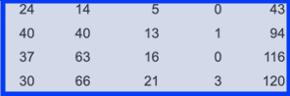
Data Sources
FLIGHTIFY
National Centers for Environmental Information
NOAA: National Oceanic and Atmospheric Administration
Notes:
The FAA provided several databases from which we were able to query and create tailored reports during our data exploratory phase. The Operational Network (OPSNET) database became our primary data source for flight operations. This view below includes daily flight traffic for Fairbanks, AK, grouped by Flight Rules/Type and further grouped by user classes (i.e. Air Carrier, Air Taxi General Aviation, Military)
In an effort to reduce extensive internal data pulls, we leveraged an FAA public database (OPSNET) to pull 500 excel sheets for our airports.

Slide 11
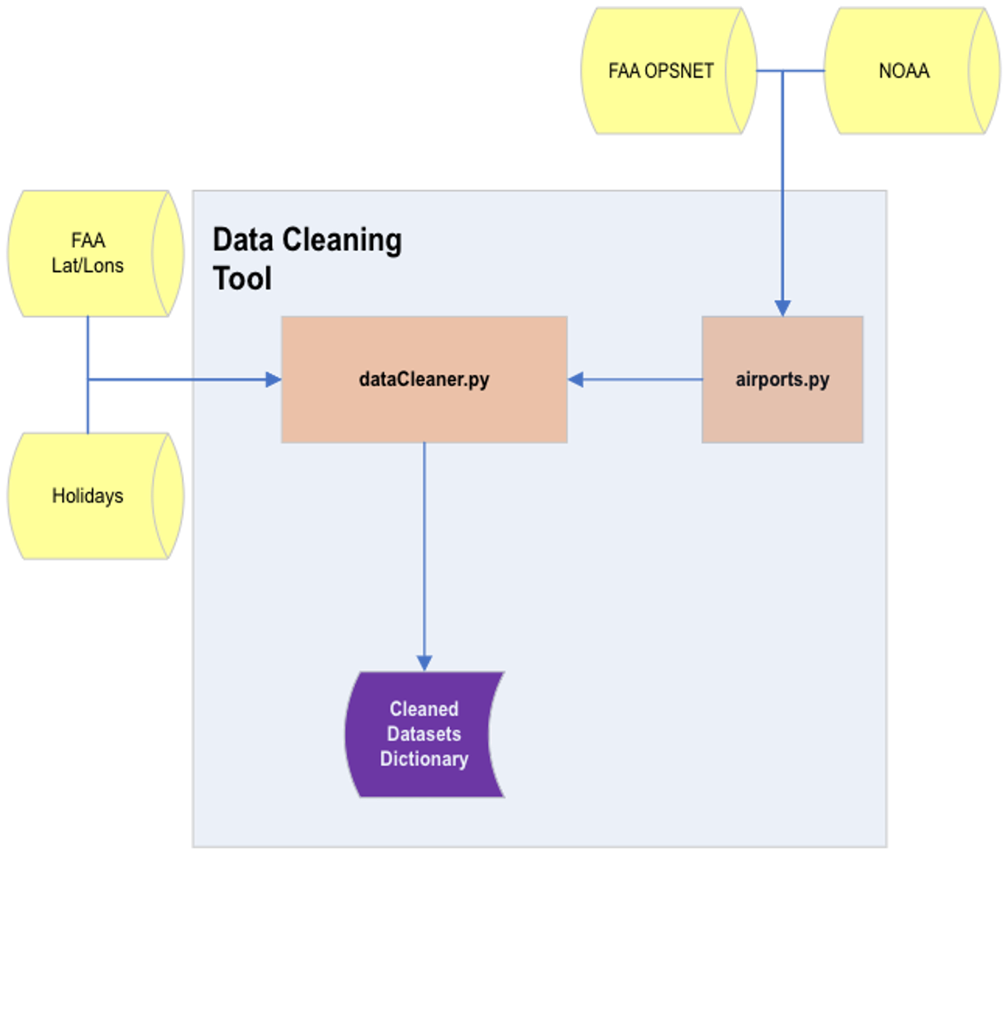
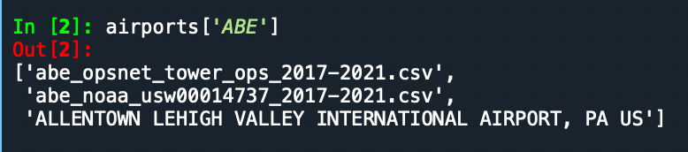
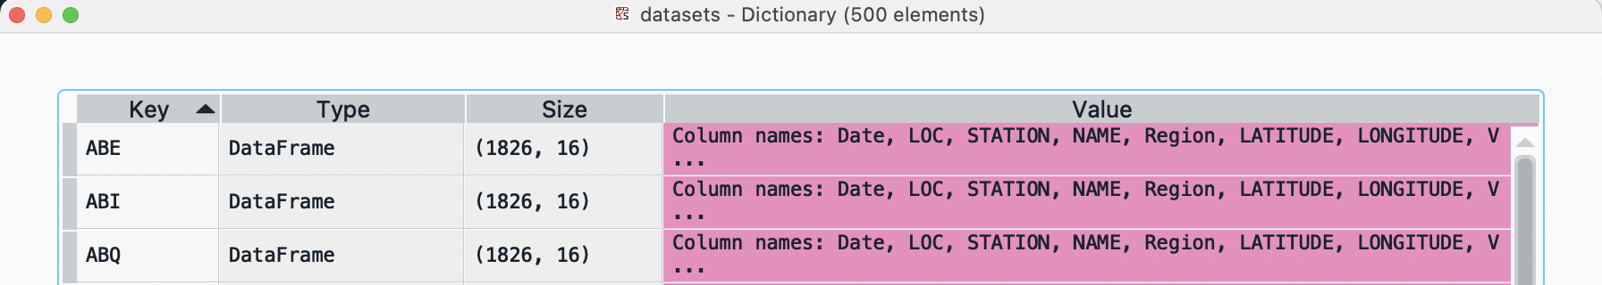
Data Wrangling
FLIGHTIFY
Iteratively performs ETL transformations for 500 airports
Uses iterators, lists, list of lists, dictionaries, etc.
FOR LOOPS!
Packages
Pandas
NumPy
OS
Custom Modules
airports.py
dataCleaner.py
Output Data
datasets
Automates the creation of the airports dictionary
ABE
Data ingestion
Text removal
Variable relabeling
Text cleaning (commas)
Type conversion
Variable transformations
Mean imputation
Geographical coordinate conversion and remapping

Slide 12
DATA MODELING & EVALUATING
Notes:
Talk about what didn't work
-re-assessed what partner was asking for
-tried multiple modeling types (monte-carlo, linear regression with time lags, multiple linear regression)

Slide 13
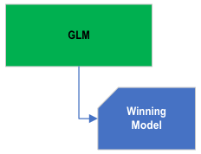
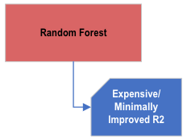
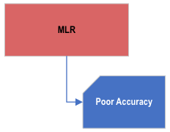
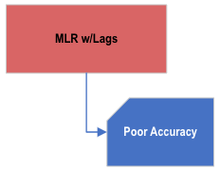
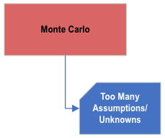
Modeling Journey
FLIGHTIFY

Slide 14
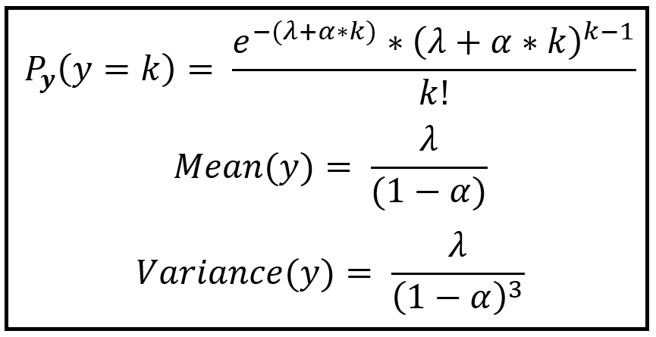
Visualization and Machine Learning Slides
FLIGHTIFY
Consul's GP-1 Generalized Poisson Regression Model
Model VFR counts as a modified Poisson Process
Introduces Dispersion parameter- allows difference in Mean and Variance
Handles Over-dispersed and Under-dispersed data
Random selection of Training /Test- set 80%/20%
Image Copyright Sachin Date https://timeseriesreasoning.com/contents/generalized-poisson-regression-model/

Slide 15
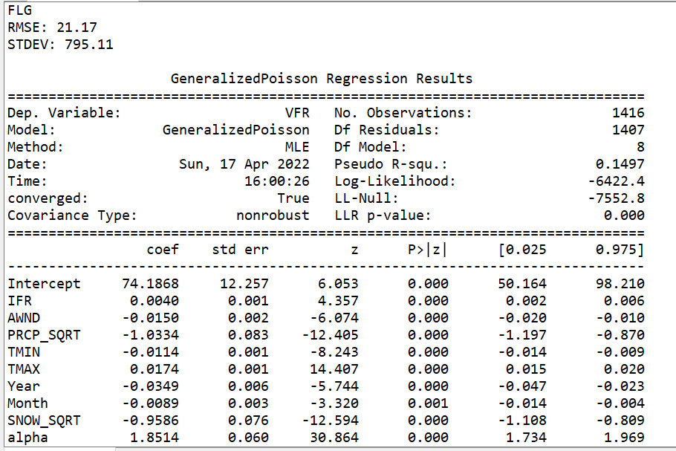
Machine Learning Model Results
FLIGHTIFY
P-values
Log-Likelihood
LL-Null
Pseudo R-Squared =
1-(Log_Likelihood/LL_Null)
LLr p-value

Slide 16
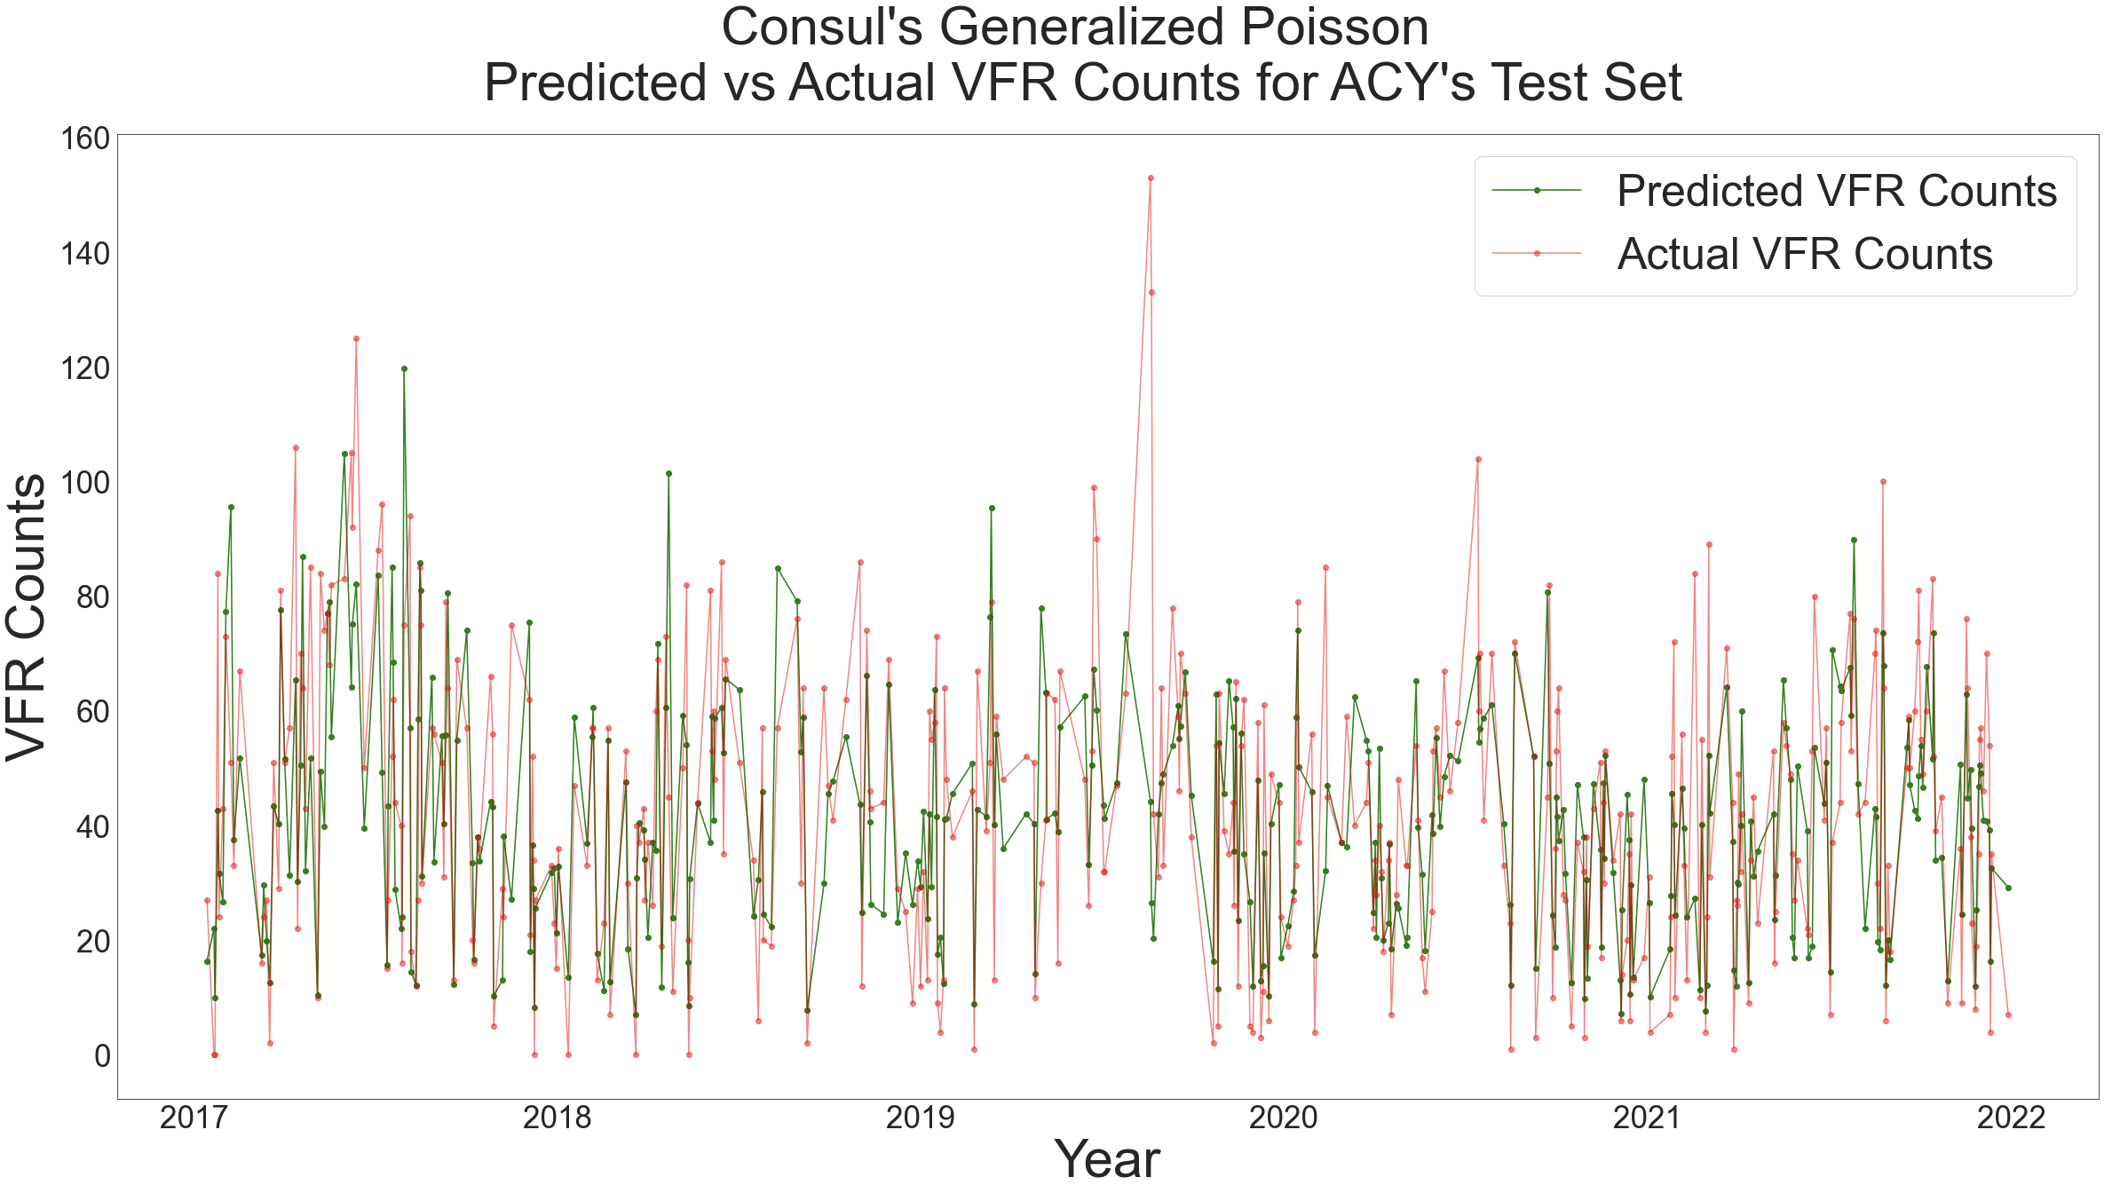
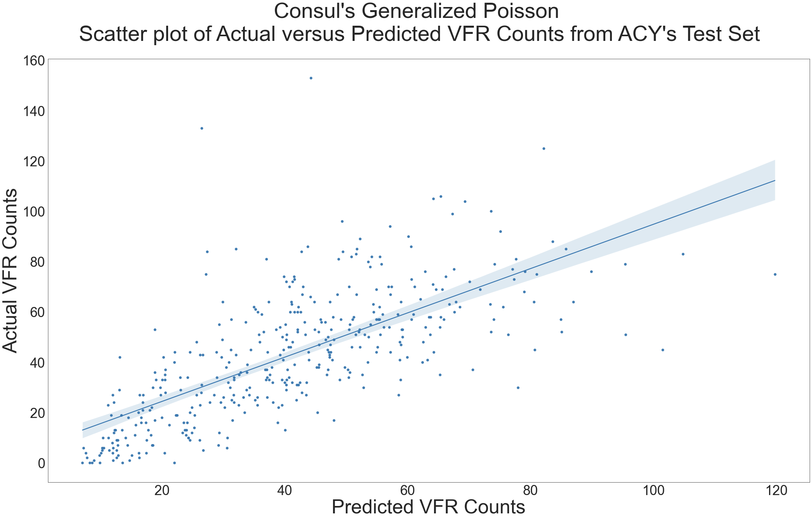
Machine Learning Visualizations
FLIGHTIFY

Slide 17
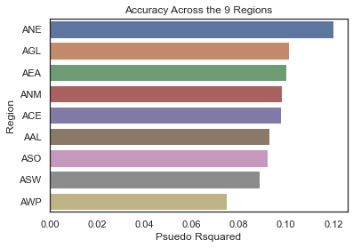
Machine Learning Model Evaluation
FLIGHTIFY

Slide 18
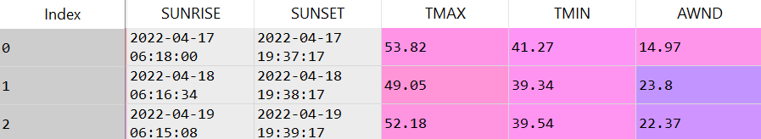
Forecast Future VFR
Day | VFR Forecast
Current | 23.8022
Day 1 | 11.2787
Day 2 | 21.2392
Day 3 | 39.2172
Day 4 | 37.1781
Day 5 | 42.5469
Day 6 | 19.4273
Day 7 | 29.658
FLIGHTIFY
Iterates 500 airports
No need to run Model Module every time
Weather inputs pulled from Open Weather Map API
Automatically pulls weather predictors for 500 airports
JSON Response, builds Forecast DataFrame
Predict VFR Forecast for current and next 7 days
Create csv's for Dashboard and Shapefile Module
ACY Atlantic City International Airport
API Pull

Slide 19
RESULTS, CONCLUSION & NEXT STEPS

Slide 20
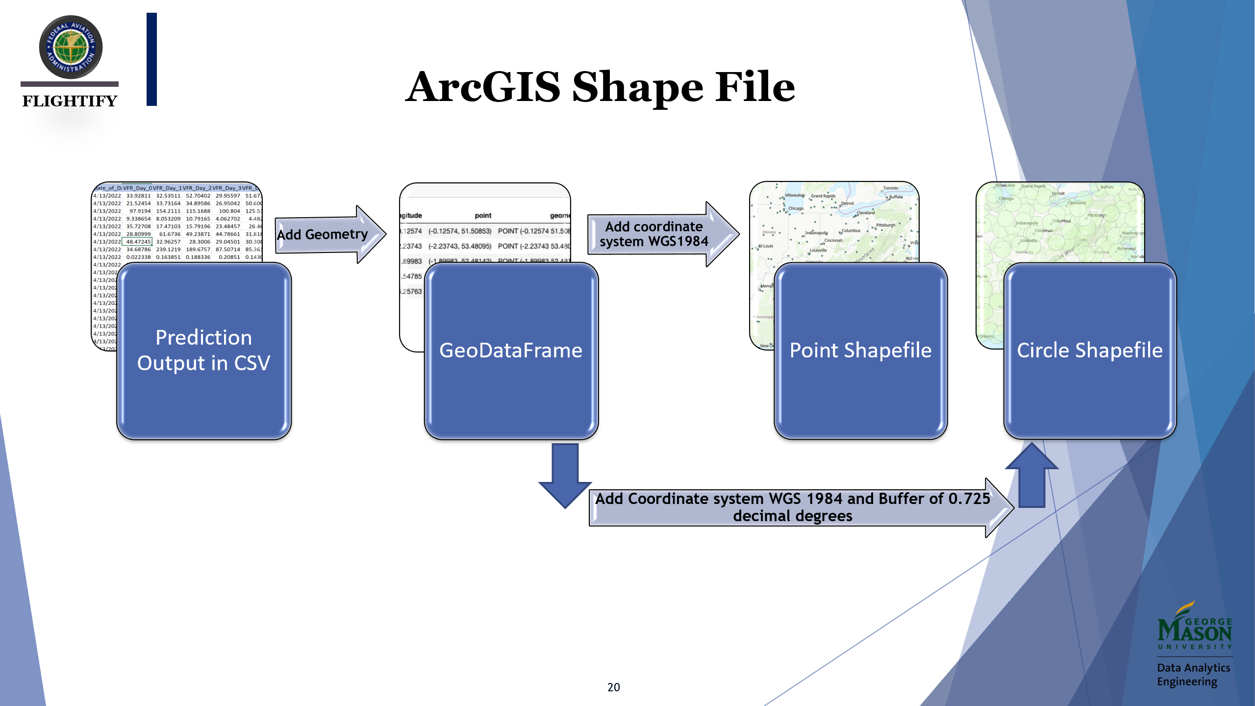
FLIGHTIFY

Slide 21
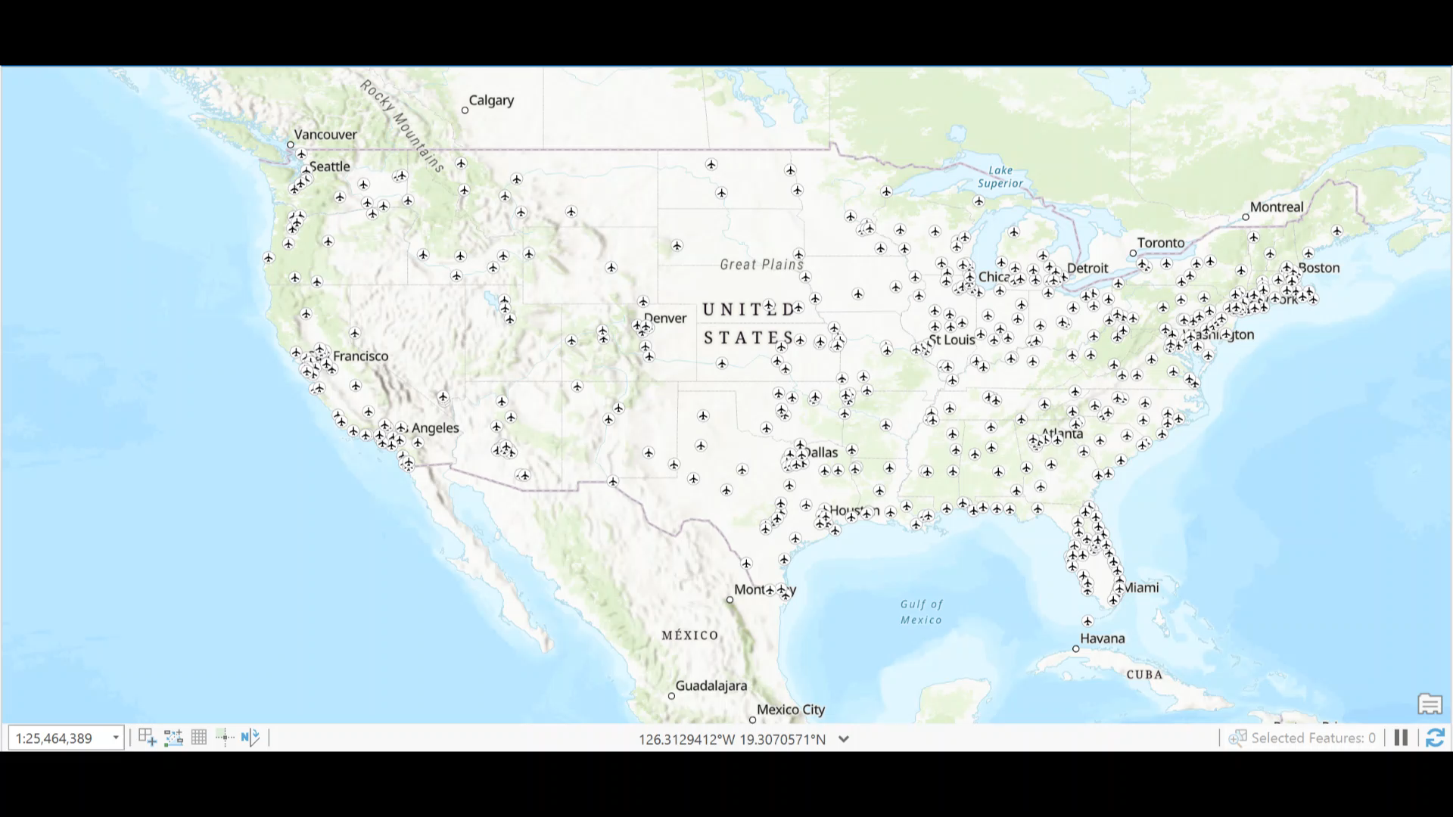
ArcGIS Sample Layer
FLIGHTIFY

Slide 22
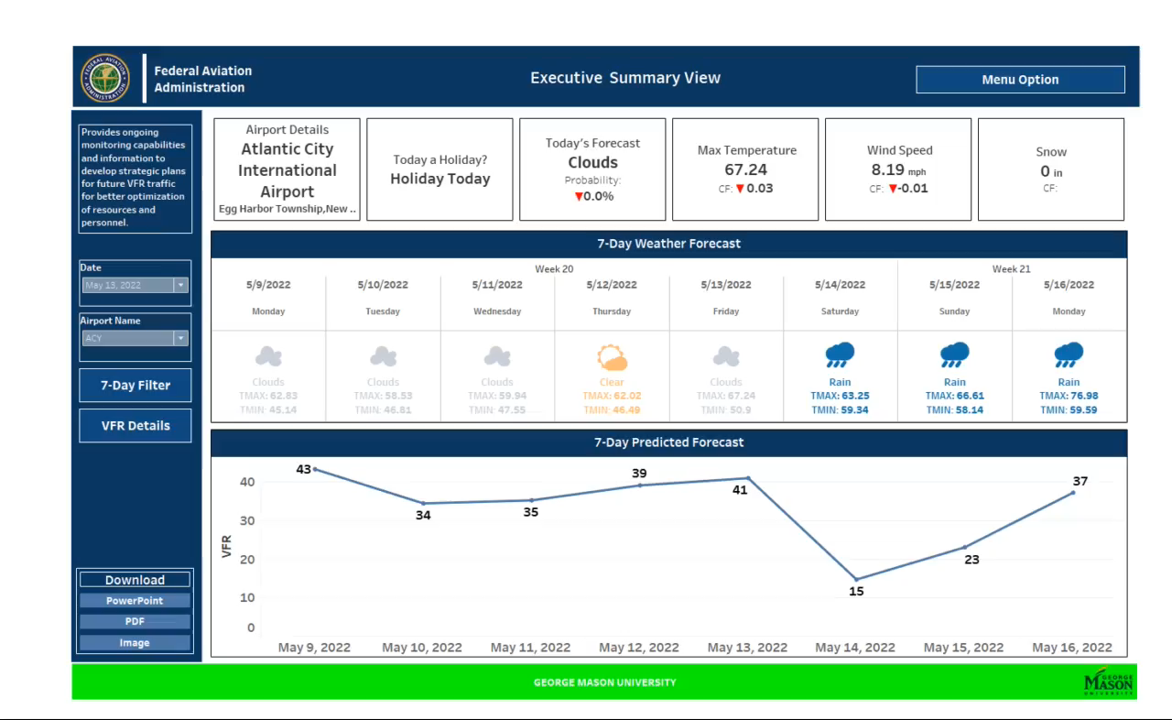
Tableau Dashboard – Demo
FLIGHTIFY
Notes:
Combine executive and national map
ACY looks better visually, FLG highest pseduo r sqaured not pretty
4-20 Notes
We do not need holiday

Slide 23
Summary Slides
FLIGHTIFY
Flightify 2.0 Solution
 | Deliverables: Data Cleaner Module, airport.py, datasets, Model and Forecast Modules, ArcGIS Layer, and Tableau dashboard Key features: Predictive model for each airport, dictionary that ingest several datasets, Tableau dashboard monitor airports VFR values and variables associated
 | Accuracy: .149 pseud0 R-Sqaure Scalability: Up to 500 airports Customized: Each airport has a specific predictive model associated with it Collaborative/ Sharable: Multiple users can use the Tableau workbook. Python code and ARCGIS layer Cost: Current state no expense was incurred
Overview
Benefits

Slide 24
Next Steps & Recommendations
FLIGHTIFY
Recommendation:
FAA adopts Generalized Poisson Regression approach for their predictions to achieve their business and technical goals, while preserving data retention and reporting capabilities. The Flightify 2.0 team recommends prioritizing the following steps below for further improvements::
Preprocess:
1.) Improve running time of Data Cleaner module.
2.) Increase data scalability.
3.) Integrate Open weather data.
4.) Create API for public to query from database.
Model:
5.) Find more predictors.

Slide 25
FLIGHTIFY
Questions?

